Slide 1
ECE 901
Epilogue
Large-scale Machine Learning
and Optimization

Slide 2
ML Pipelines
Test Data
Input Data
Feature
and Model Selection
Training
Model

Slide 3
ML Pipelines
Test Data
Input Data
Feature Selection
Training
Model
Google’s deep nets can take 100s hrs to train
[Dean et al., 2012]

Slide 4
Why Optimization?

Slide 5
OPT at the heart of ML
Measures model fit
for data point i
(avoids under-fitting)
Measures model
“complexity”
(avoids over-fitting)

Slide 6
Solvability ≠ Scalability
Many of the problems that we visit, can be solved in polynomial time, but that’s not enough.
E.g.,
O( #examples^4 * dimension^5 ) not scalable
We need fast algorithms!
Ideally O(#examples * #dimension) time
We want algorithms amenable to parallelization!
if serial runs in O(T) time, we want O(T/P) on P cores.

Slide 7
Performance Trade-off
We want our algorithms to be here
stat. accuracy
speed
parallelizability

Slide 8
This course
Algorithms / Optimization
Statistics
Systems

Slide 9
Goals of this course
Learn new algorithmic tools for large-scale ML
Produce a research-quality project report

Slide 10
What we covered
Part 1:
ERM and Optimization
Convergence properties of SGD and Variants
Generalization performance, Algorithmic Stability
Neural Nets
Part 2:
Multicore/Parallel Optimization
Serializable Machine Learning
Distributed ML
Stragglers in Distributed Computation

Slide 11
What we did not cover
0-th order optimization
Several 1-st order based algorithms: Mirror Descent, Prox., ADMM, Accelerated GD, Nesterov’s Optimal Method,…
Second order optimization
Semidefinite/Linear Programming
Graph Problems in ML
Sketching/Low-dimensional embeddings
Model Selection
Feature Selection
Data Serving
Active Learning
Online Learning
Unsupervised Learning

Slide 12
Recap

Slide 13
Gradients at the core of Optimization
Gradient Descent
Stochastic Gradient
Stochastic Coordinate
Frank-Wolfe
Variance Reduction
Projected Gradient

Slide 14
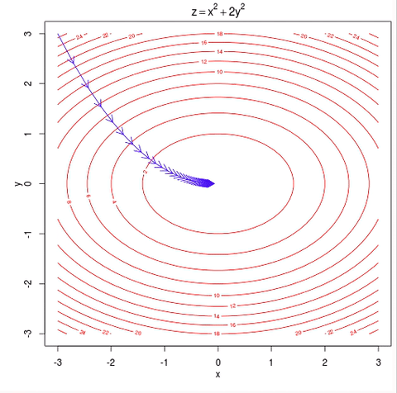
Convergence Guarantees
TL;DR:
Structure Helps

Slide 15
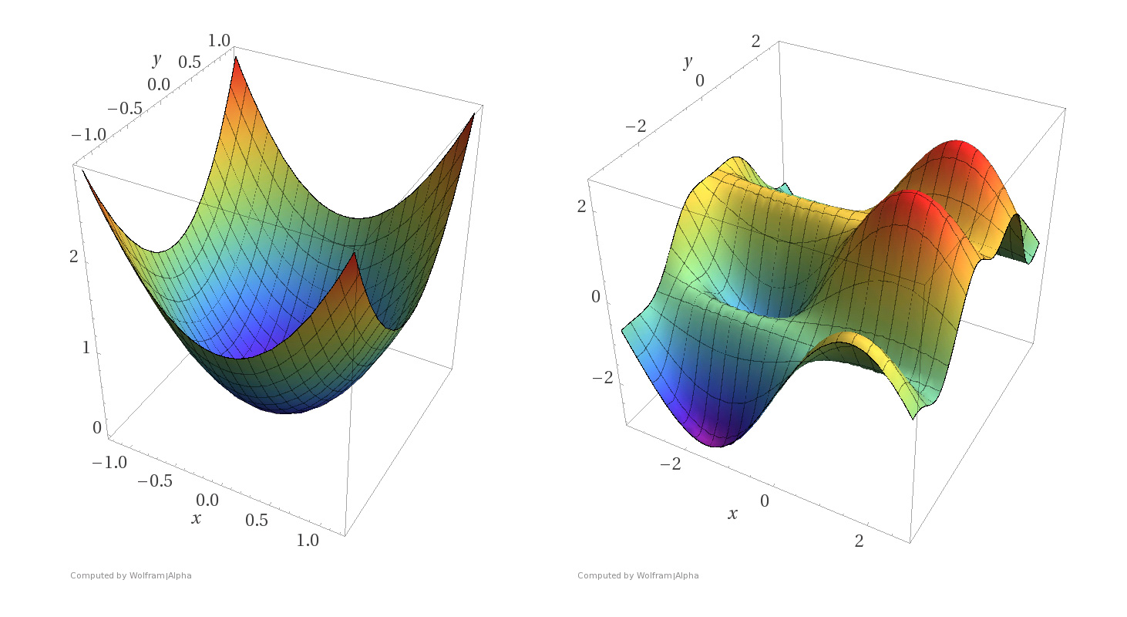
Convexity
TL;DR:
We can solve any convex problem

Slide 16
Non-Convexity
TL;DR:
For general non-convex, only grad. convergence

Slide 17
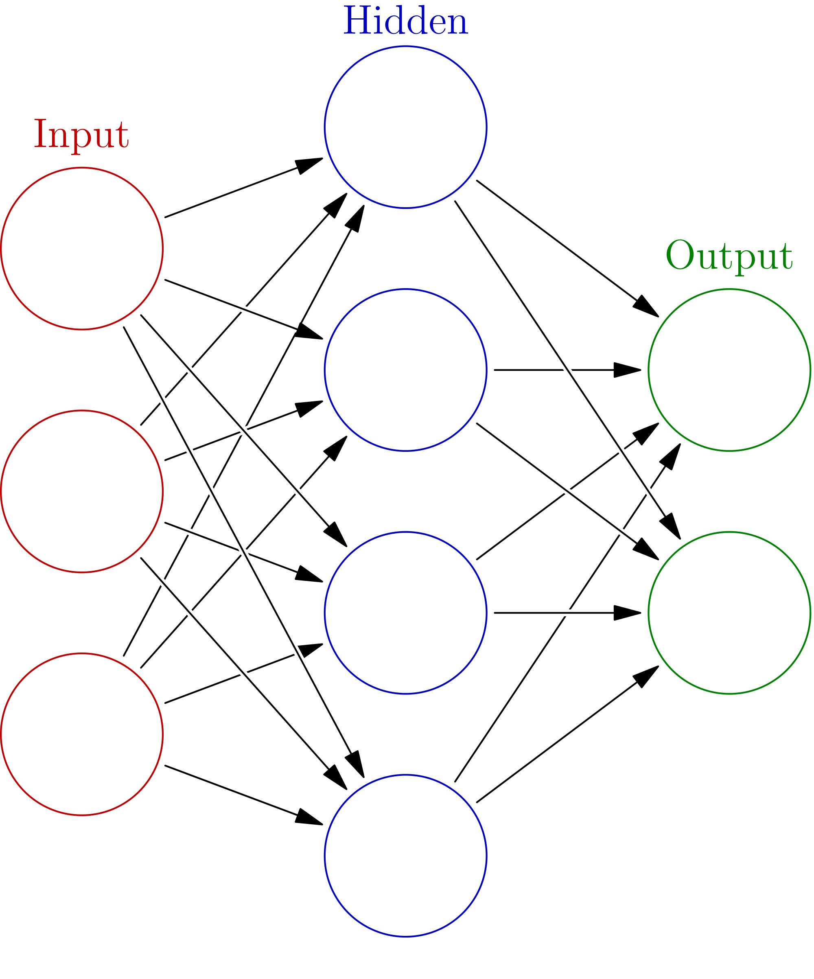
Neural Nets
TL;DR:
Very expressive, very effective, very hard to analyze

Slide 18

Algorithmic Stability
TL;DR:
Stability => Generalization

Slide 19
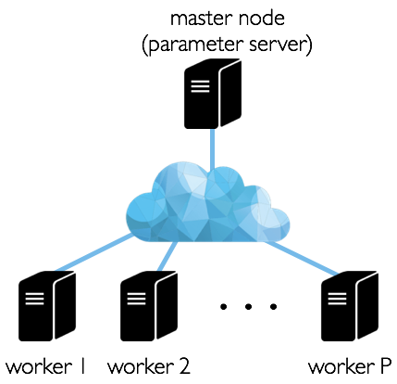
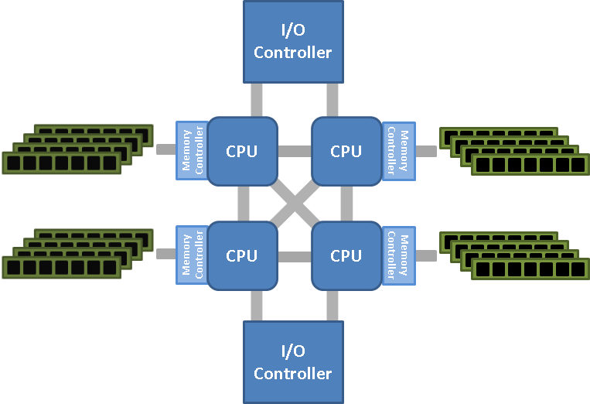
Parallel and Distributed ML
Multi-socket NUMA
TL;DR:
We still don’t have a good understanding

Slide 20
Course TL;DR
Stochastic Gradient is almost always
almost the answer

Slide 21
Many Open Research Problems

Slide 22
Parallel ML

Slide 23
Open Problems: Asynchronous Algorithms
Asynchronous algorithms great for Shared Memory Systems
Issues when scaling across nodes
Similar Issues for Distributed:
speedup
#threads
O.P. :
How to provably scale on NUMA?
O.P. :
What is the right ML Paradigm
for Distributed?

Slide 24
Open Problems: Asynchronous Algorithms
Assumptions:
Holy grail:
Sparsity + convexity => linear speedups
O.P. :
Hogwild! On Dense Problems
Only soft sparsity needed = uncorrelated sampled gradients
Maybe we should featurize dense ML Problems,
so that updates are sparse
Fundamental Trade-off Sparsity vs Learning?
O.P. :
Hogwild! On Non-convex Problems

Slide 25
Distributed ML

Slide 26
Open Problems: Distributed ML
How fast does distributed-SGD converge?
How can we measure speedups?
Comm. is expensive, how often do we average?
How do we choose the right model?
What happens with delayed nodes?
Does fault tolerance matter?

Slide 27
Open Problems: Distributed ML
Some models are better from a systems perspective
Does it fit in a single machine?
Is model architecture amenable
to low communication?
Some models easier to partition
Can we increase sparsity (less comm)
without losing with accuracy?

Slide 28
Open Problems: Distributed ML
Stong Scaling

Slide 29
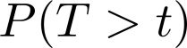
Open Problems: Distributed ML
f=f₁+f₂+f₃
Measured on Amazon AWS
f₁
f₂
f₃
t: latency (second)
How to mitigate
Straggler Nodes?
f₁
f₂
f₃

Slide 30
Open Problems: Distributed ML
f=f₁+f₂+f₃
Measured on Amazon AWS
f₁
f₂
f₃
t: latency (second)
How to design algorithms robust to delays?
f₁
f₂
f₃

Slide 31
Open Problems: Distributed ML
Coded computation with low decoding complexity
Nonlinear / nonconvex functions
Expander Codes to the Rescue?
Most times “lossy” learning is fine, maybe “terminate” slow nodes?
f=f₁+f₂+f₃+f₄
f₁
f₂
f₃
f₄
f₁+f₂+f₃+f₄

Slide 32
Learning Theory

Slide 33
Open Problems: Stability
Can we test Stability of algorithms in sublinear time?
Classes of Noncovnex problems that SGD is stable?
What Neural Net architectures lead to Stable Models?

Slide 34
Open Problems: Stability/Robustness
Well trained models, with good error, exhibit low robustness
prediction(model, data) ≠ prediction(model, data+noise)
Theory question:
How robust are models trained by SGD?
Theory question:
If we add noise to training, does it robustify the model?

Slide 35
What is the right SW platform?

Slide 36






Machine Learning On Different Frameworks

Slide 37
What is the right HW platform?

Slide 38
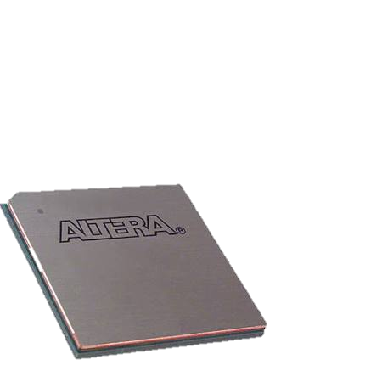
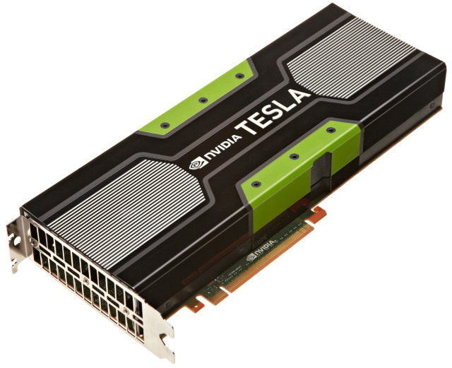

Machine Learning On Different Platforms
Q: How do we optimize ML for
NUMA Architectures?
Q: How do we parallelize ML
across mobile devices?
Q: Should we build hardware
optimized for ML algorithms? (FPGAs?)
Q: ML on GPUS

Slide 39
The Driving Question
How can we enable
Large-Scale Machine Learning
On New Technologies?
ML Algorithms
Systems

Slide 40

You want to be here!

Slide 41
Survey

